Slide 1

JAVA Project: ICECREAM BILLING SYSTEM
By 21sw072

Slide 2
Introduction
Ice Cream Billing System is a project which stores the order of the user and then displays the total bill. User also gets an option to read the menu which itemizes the price of individual details of an ice Cream.
The order is stored in a json file.
Github Link:
https://github.com/Rubesha27/IcecreamBillingSystem.git

Slide 3
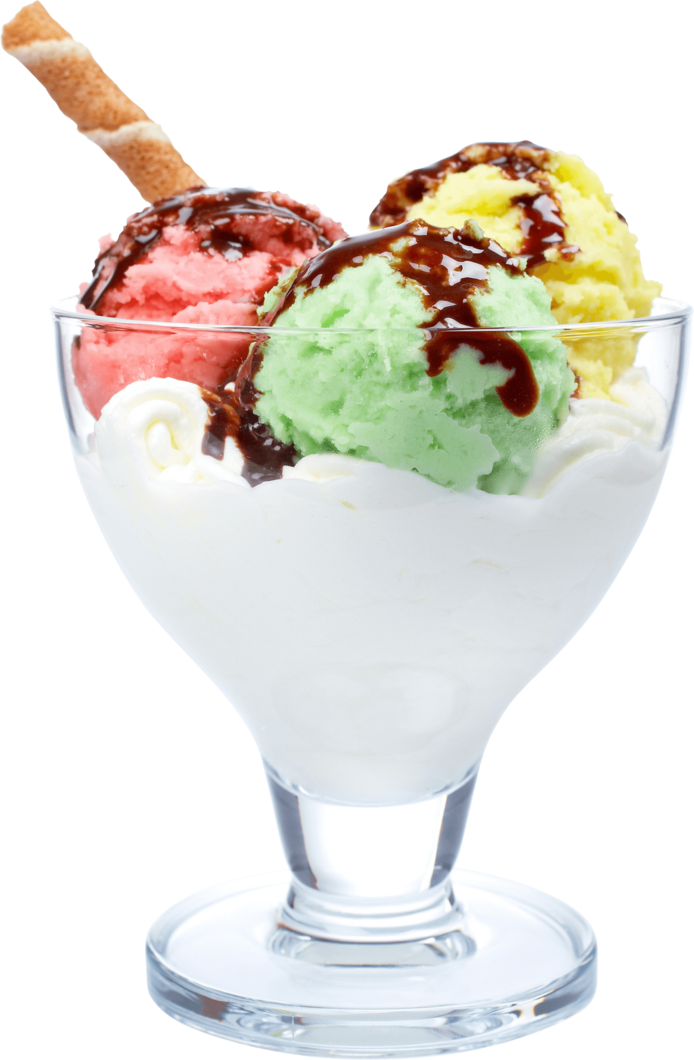
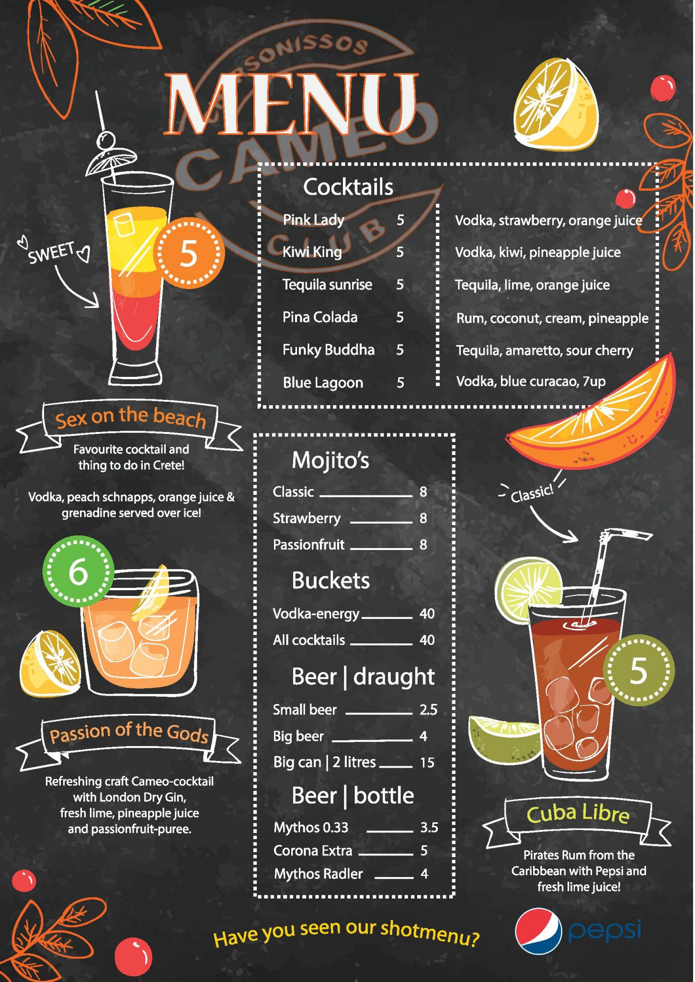
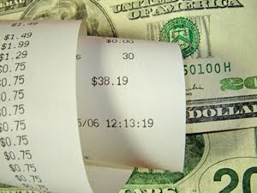
Modules:
Order icecream
See the total bill
Read the menu

Slide 4
CONCEPTS USED:
01
Objects and classes
04
Exception handling
02
Multi-Threading
05
Graphical user interface
03
File handling
Real world entity, Ice cream is used as a class.
All the possible exceptions are handled well.
Splash screen demonstrates the use of multi threading.
Project has well defined and user friendly interface.
The order of the user gets stored in json file.

Slide 5
Project begins with …….
A splash screen frame

Slide 6
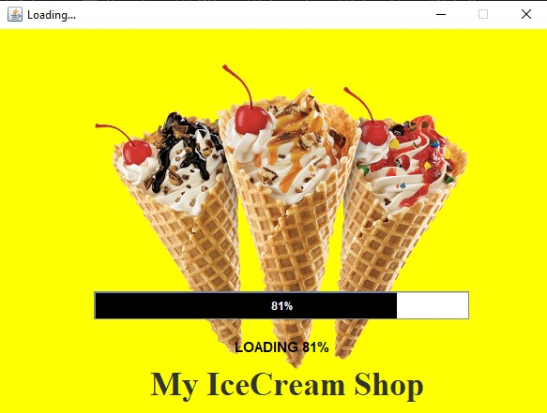
Splash Screen Frame

Slide 7
Next comes the main frame….
Order your Ice cream

Slide 8
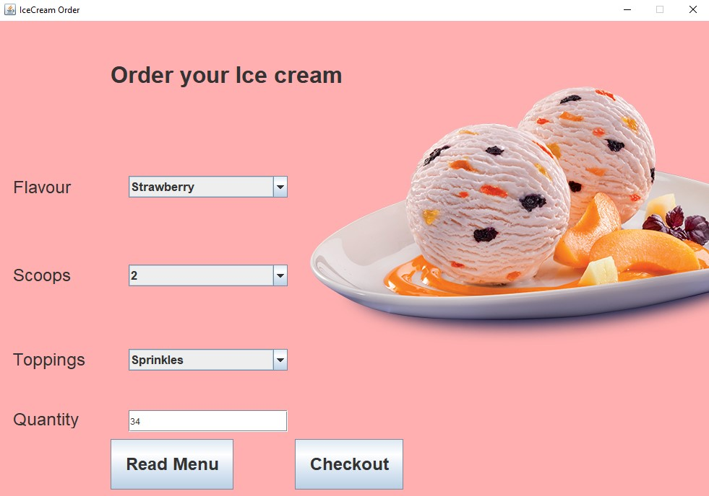
MAIN Frame

Slide 9
Read menu button…….
Shows menu to the user.

Slide 10
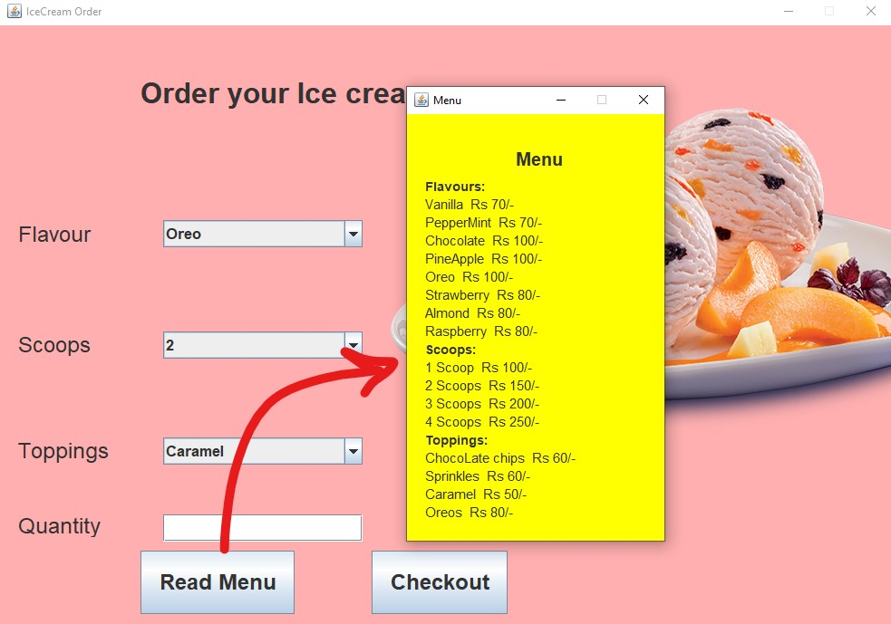
menu Frame

Slide 11
Checkout button…….
Shows bill to the user.

Slide 12
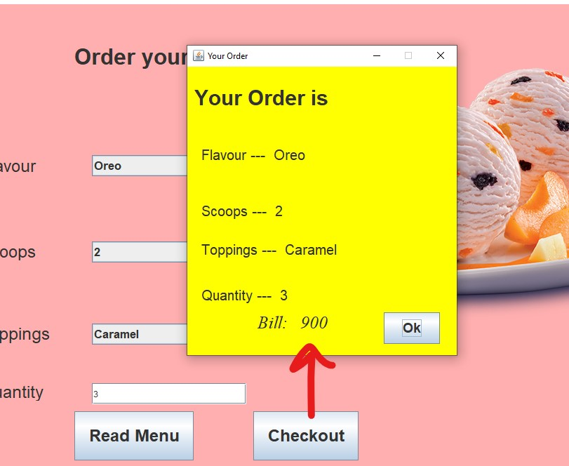
Check out frame

Slide 13
CONFIRMation message..
Asks confirmation from the user.

Slide 14
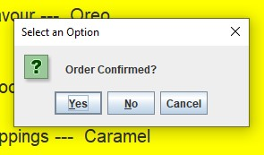
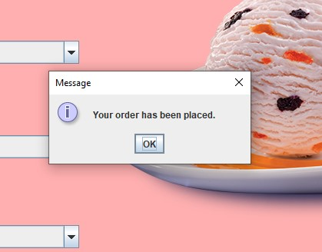
confirmation message
If user clicks yes

Slide 15
Exceptions handled…
If user enters 0 in the quantity field.
If user enters decimals values in the quantity field.

Slide 16
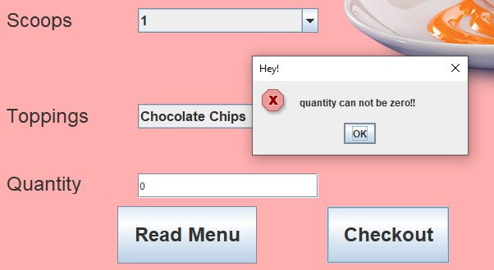
Exception # 01
If user types zero as quantity

Slide 17
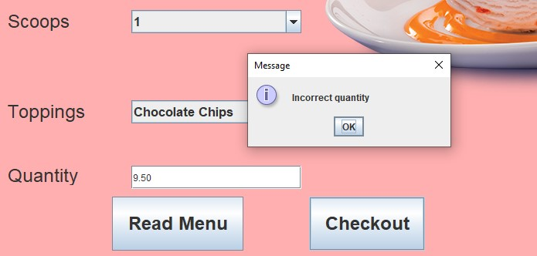
Exception # 02
If user types decimal number as quantity

Slide 18
Thank you!

